Slide 1
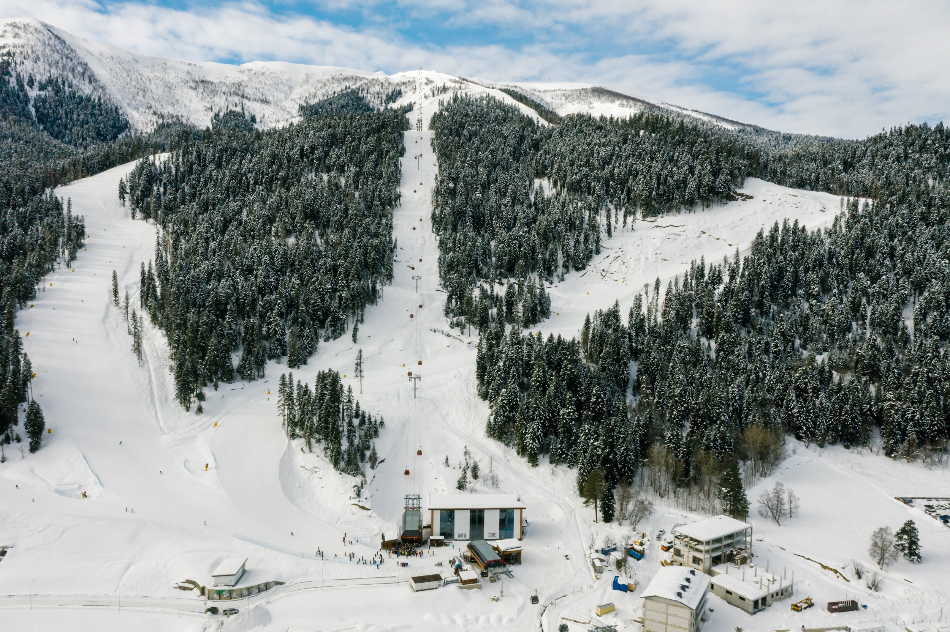
Big Mountain Resort Ticket Pricing Optimization
Presented by: Steven Walters

Slide 2
The Problem
How can Big Mountain Resorts determine the importance of facilities within its market segment to help inform its investment strategy and optimize ticket pricing?
OR
How does Big Mountain Resorts increase revenues while remaining competitive?

Slide 3
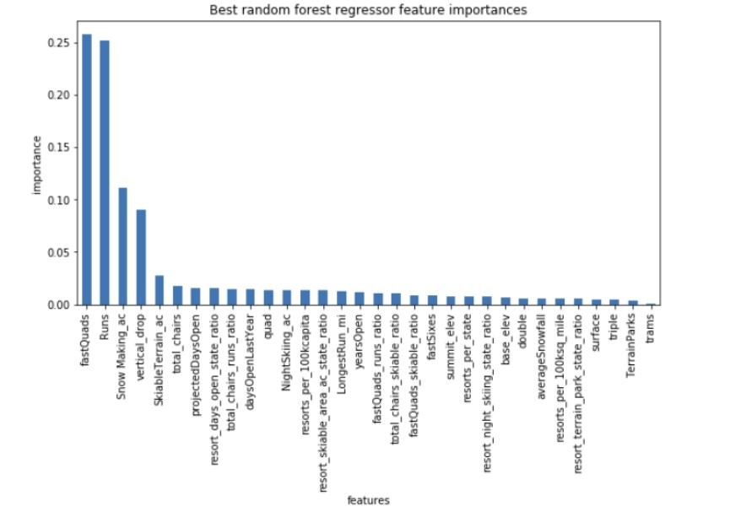
Our Key Findings
Four features were found to have a strong positive correlation with ticket pricing:
fastQuads
SnowMaking_Ac
Runs
Vertical_drop

Slide 4
Model Recommendations
During the course of the modeling, management team shared 4 different scenario and those scenarios are listed below. Recommendations based on each scenario will follow.
Scenario 1: Permanently close down up to 10 of the least used runs in order to reduce the operating cost of the company.
Scenario 2: Increase the vertical drop by adding a run to a point 150 feet lower down but requiring the installation of an additional chair lift to bring skiers back up, without additional snow making coverage.
Scenario 3: Same as Scenario 2 with additional snow making coverage of 2 acres.
Scenario 4: Increase the longest run by 0.2 miles and guaranteeing its snow coverage by adding 4 acres of snow making capability.

Slide 5
Scenario 1: Permanently close down up to 10 of the least used runs in order to reduce the operating cost of the company.
Based on the model, the team should consider closing a minimum of one run and ideally 6-10 of the least used runs. The model suggests that closing one run would result in no difference in revenue. Closing two runs reduced revenue, and closing three runs reduces revenue further. There is no further change in revenue when closing four or five runs. After 6 runs are closed there isn’t as large a reduction in revenue so it may be more profitable to keep 6-10 of the least used runs closed unless they are at max capacity.

Slide 6
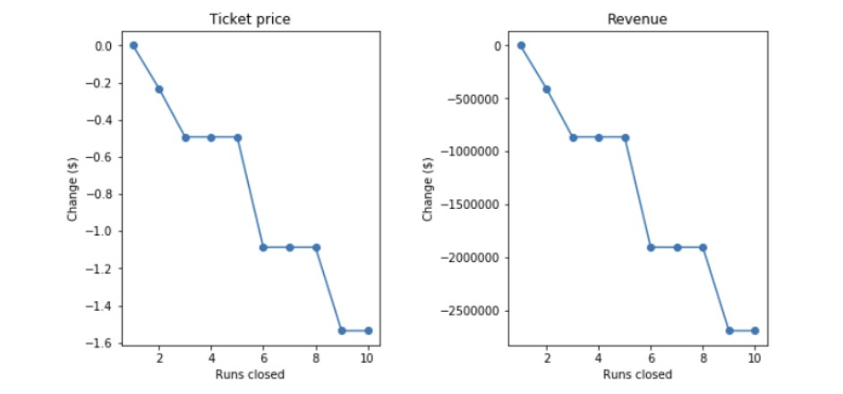

Slide 7
Scenario 2: Increase the vertical drop by adding a run to a point 150 feet lower down but requiring the installation of an additional chair lift to bring skiers back up, without additional snow making coverage.
Based on the model, in this scenario Big Mountain can increase the ticket prices by $1.99 which will amount to increase in revenue by $3,474,638 over the season. This is based on current visitor numbers of 350,000 per season, with an average stay of 5 days.

Slide 8
Scenario 3: Same as Scenario 2 with additional snow making coverage of 2 acres.
Based on the model adding the additional snow making coverage provides no increase in the revenue. Additionally, the capital cost as well as the operating cost will go up due to additional snow coverage, hence this is not recommended.

Slide 9
Scenario 4: Increase the longest run by 0.2 miles and guaranteeing its snow coverage by adding 4 acres of snow making capability.
Based on the model there is no increase in the revenue when increasing the longest run and adding 4 acres of snow making capacity. Additionally, the capital cost as well as the operating cost will go up due to additional snow coverage, hence this is not recommended.

Slide 10
Recommendations
Raise ticket prices to $95.87 based on model feedback. This can be justified to customers by highlighting all the top-tier amenities and features offered at Big Mountain Resorts.
Have 4-6 runs closed each day to save on operation costs.
Increase vertical drop by lowering a run 150ft.

Slide 11
Next Steps
Work with the marketing team to analyze the relationships between ticket pricing and resort facilities based on their experience and if required by engaging a resort pricing consultant.
Keep fine-tuning the model to increase its predictability accuracy.
Build a production ticket pricing model to empower the marketing team to continue to explore potential opportunities to reduce costs and increase revenues.

